Slide 1
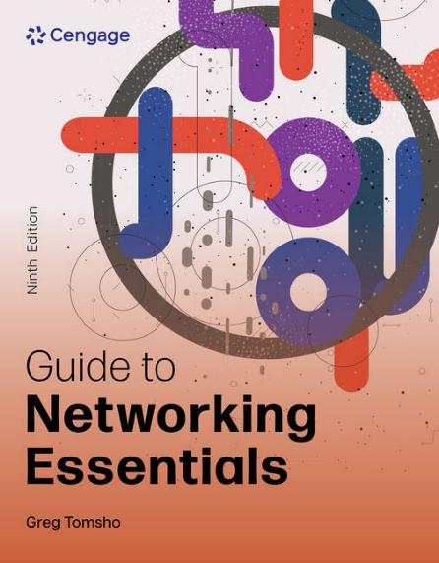
Guide to Networking Essentials, 9e
Chapter 5: Network Protocols
.

Slide 2
Chapter Objectives
By the end of this chapter, you should be able to:
Describe the purpose of a network protocol and the layers in the TCP/IP architecture
Describe TCP/IP Application layer protocols
Describe TCP/IP Transport layer protocols
Describe TCP/IP Internetwork layer protocols
Describe TCP/IP Network access layer protocols

Slide 3
TCP/IP’s Layered Architecture (1 of 5)
Protocols are rules and procedures for communication and behavior
Computers must “speak” the same language and agree on the rules of communication
When a set of protocols works cooperatively it is called a protocol suite (or “protocol stack”)
The most common protocol stack is Transmission Control Protocol/Internet Protocol (TCP/IP)
TCP/IP is composed of more than a dozen protocols operating at different levels of the communication process

Slide 4
TCP/IP’s Layered Architecture (2 of 5)
Example of how the layers work together:
Your web browser’s home page is http://www.cengage.com
The web browser formats a request by using the Application layer protocol HTTP
The request looks something like Figure 5-2 (see the following slides)
The unit of information used at the Application layer is called “data”
The Application layer protocol HTTP passes the request down to the Transport layer protocol (TCP)
TCP adds a header to the request that looks like Figure 5-3 (see the following slides)

Slide 5


TCP/IP’s Layered Architecture (3 of 5)
Figure 5-2 The Application layer creates data
Figure 5-3 The Transport layer adds its header to make a segment

Slide 6
TCP/IP’s Layered Architecture (4 of 5)
Example of how the layers work together (continued):
The unit of information the Transport layer works with is called a segment
TCP passes the segment to the Internetwork layer protocol (IP)
IP places its header on the segment (see Figure 5-4)
The unit of information is now called a packet
The packet is passed down to the NIC at the Network access layer
A frame header and trailer are added (see Figure 5-5)
The frame is delivered to the network medium as bits
The Web server processes it and returns a Web page

Slide 7


TCP/IP’s Layered Architecture (5 of 5)
Figure 5-4 The Internetwork layer creates a packet
Figure 5-5 The frame is created and ready for delivery on the medium

Slide 8
Application Layer Protocols
The Application layer provides network services to user applications that access network resources
The Application layer provides these functions:
Access to network services by applications
Client/server data access
Name resolution
Dynamic address assignment
Authentication/user logon
Data formatting and translation, including encryption/decryption

Slide 9
HTTP: Protocol of the World Wide Web
Originally, HTTP’s main purpose was to transfer static web pages written in HTML
Now, it is used for general file transfer, downloading/displaying multimedia files, and executing scripts for animated/interactive Web pages
HTTP uses TCP as its Transport layer protocol
The default TCP port number is 80

Slide 10
E-Mail Protocols: POP3, IMAP, and SMTP
Post Office Protocol version 3 (POP3) is used to download incoming messages from e-mail servers to local desktops
POP3 uses TCP port 110
Internet Message Access Protocol version 4 (IMAP4) is used to manage email messages locally yet stores them on a server
IMAP4 uses TCP port 143
Simple Mail Transfer Protocol (SMTP) is the standard protocol for sending email over the Internet
SMTP uses TCP port 25

Slide 11
FTP, SFTP, and TFTP
File Transfer Protocol (FTP) is a client/server protocol used to transfer files and manage files across a network (not a secure protocol)
FTP uses TCP ports 20 and 21
SFTP provides secure file transfer using SSH on TCP port 22
Trivial File Transfer Protocol (TFTP) is a simple protocol for transferring files
TFTP has little file management capability
It uses UDP port 69

Slide 12
Server Message Block
Server Message Block (SMB) is the protocol Windows file and printer services use to share resources between Windows computers
SMB is used almost exclusively in a private network instead of across the Internet
Linux and Mac OS X also support SMB with their own variations
SMB uses TCP port 445

Slide 13
Remote Desktop Protocol
Remote Desktop Protocol (RDP) is used to access a Windows computer remotely by using the Windows graphical user interface (GUI)
RDP is used to run Windows applications remotely and network administrators use it to manage Windows workstations and servers remotely
RDP uses TCP port 3389

Slide 14
Telnet and SSH
Telnet and Secure Shell (SSH) are used to connect to a device across a network via a command-line interface
Network administrators might use Telnet or SSH to connect to a managed switch or router
Telnet uses TCP port 23
It is not a secure protocol
SSH uses TCP port 22 and provides an encrypted channel between the client and server

Slide 15
Simple Network Management Protocol
Simple Network Management Protocol (SNMP) is used to monitor and manage network devices and gather statistics about network traffic
Software agents are installed on devices you want to monitor and manage
Agents collect data and transfer it to a network management station for storage and analysis
SNMP operates on UDP ports 161 and 162

Slide 16
Network Time Protocol
Network Time Protocol (NTP) is used by computer systems and networking devices to synchronize their clocks with an external time source
Linux and Unix computers attempt to connect to public NTP servers using the address pool.ntp.org
Mac OSs use time.apple.com by default
Windows uses time.windows.com by default
NTP uses UDP port 123

Slide 17
Dynamic Host Configuration Protocol (1 of 5)
Dynamic Host Configuration Protocol (DHCP) is used to automatically assign IP addresses as needed
When a computer is turned on, it requests an IP address from a server that is configured as a DHCP server
The request is sent in the form of a broadcast message
The server assigns an address for a specific amount of time (called a lease)

Slide 18
Dynamic Host Configuration Protocol (2 of 5)
A DHCP server is composed of the following:
IP address pool—a range of IP addresses the server leases to clients
Pool options—IP settings such as default gateway, DNS servers, a domain name, and other options
Reservations—an IP address tied to a particular MAC address
Exclusions—one or more IP addresses excluded from the IP address pool
DHCP Server service—runs in the background and listens on UDP port 67 for IP address requests

Slide 19
Dynamic Host Configuration Protocol (3 of 5)
After an address is leased, a record of the lease is stored in a database, including a lease expiration time
When 50% of the lease time has elapsed, the computer attempts to renew the lease from the same DHCP server that originally responded
If there’s no response when the lease expires, the computer broadcasts a DCHP request for a new IP address
If no DHCP server responds, one of two things happens:
TCP/IP stops functioning
The computer assigns itself an address from a special range of addresses beginning with 169.254. (Automatic Private IP Addressing or APIPA)

Slide 20
Dynamic Host Configuration Protocol (4 of 5)
Broadcast packets used by the DHCP process:
DHCPDiscover—the client announces to the network that it’s looking for a DHCP server
DHCPOffer—the server replies and offers the client an IP address for lease
DHCPRequest—the client wants the offered IP address
DHCPAck—the server acknowledges the transaction and the client can now use the IP address
Consider assigning static addresses (that don’t change) to certain devices, such as network printers and servers

Slide 21
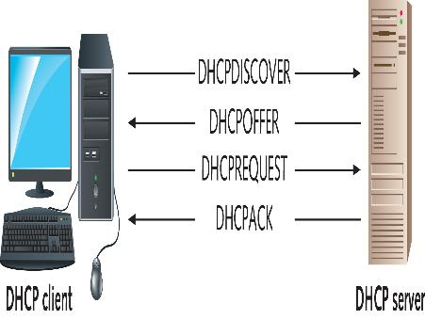
Dynamic Host Configuration Protocol (5 of 5)
Figure 5-9 A computer requesting a new IP address via DHCP

Slide 22
Domain Name System (1 of 8)
Domain Name System (DNS) is a name-to-address resolution protocol that keeps a list of computer names and their IP addresses
Example:
When you enter www.cengage.com in your Web browser, the DNS Client service contacts the DNS server specified in your OS’s IP configuration and requests that the name be resolved to an IP address
Once the IP address for the website is returned, your computer can contact the Web server to request a Web page
DNS uses UDP because DNS messages usually consist of a single packet of data

Slide 23
Domain Name System (2 of 8)
DNS is organized as a treelike hierarchy
When you put all the names of a branch together, separated by periods, you have the fully qualified domain name (FQDN)
Top-level domains are organized into categories such as commercial (.com)
Second-level domains are usually the name of a company or institution
The subdomain level is optional and can consist of names
The host level represents individual computers hosting network services

Slide 24
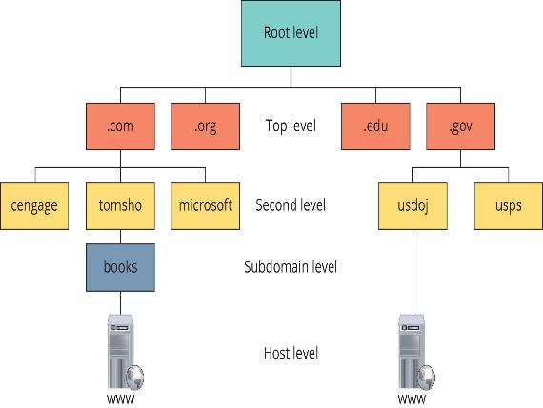
Domain Name System (3 of 8)
Figure 5-11 The DNS hierarchical tree structure

Slide 25
Domain Name System (4 of 8)
When a DNS server is installed, the administrator creates one or more domain names or zones
A zone is named by using the second-level and top-level domain names and the subdomain
A database contains a list of IP addresses that point to root servers
These servers supply addresses of top-level domain servers
DNS clients in most OSs maintain a DNS cache, called a resolver cache
This cache stores name and IP address pairs and other data for names that have been resolved recently

Slide 26
Domain Name System (5 of 8)
The DNS client is responsible for communicating with a DNS server to resolve computer and domain names to IP addresses
The DNS client is referred to as a “resolver”
An OS must be configured to use DNS and needs at least one address of a DNS server that it can query
In Windows, the first DNS server configured is called the preferred DNS server and the second one is the alternate DNS server
Windows supports Dynamic DNS (DDNS), which allows computers and other devices to contact their primary DNS server whenever their name or address changes

Slide 27
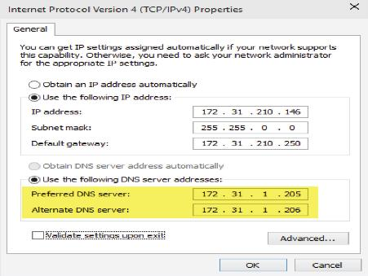
Domain Name System (6 of 8)
Figure 5-12 Preferred and alternate DNS servers in Windows

Slide 28
Domain Name System (7 of 8)
DNS servers are composed of the following:
DNS zones—a database of primarily hostname and IP address pairs
Resource records—the data contained in a zone
Cache—results of queries are cached so that if the same query occurs again, the local DNS server can respond without contacting another server
Root hints—a file containing a list of all IP addresses of Internet root servers
DNS Server service—runs in the background and listens for DNS queries on UDP port 53

Slide 29
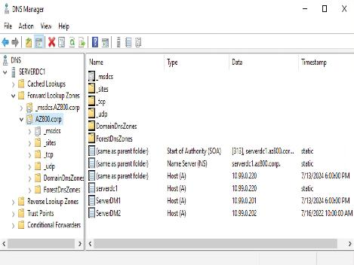
Domain Name System (8 of 8)
Figure 5-16 The DNS Manager console

Slide 30
Knowledge Check Activity 5-1
At which TCP/IP layer does the NIC operate?
a. Application
b. Session
c. Transport
d. Network Access

Slide 31
Knowledge Check Activity 5-1: Answer
At which TCP/IP layer does the NIC operate?
Answer: d. Network Access
Explanation: Network technologies such as Ethernet are defined at the Network Access layer and the NIC is a component of the Network Access layer, along with the NIC driver, cabling, and connectors.

Slide 32
Transport Layer Protocols
Transport layer protocols are used with most Application layer protocols because they accomplish the following:
Supply a header field to identify the Application layer
Provide reliability and flow control for applications that require it

Slide 33
Role of the Transport Layer (1 of 3)
The Transport layer has two protocols:
Transmission Control Protocol (TCP) is connection-oriented and designed for reliable transfer of information in complex internetworks
User Datagram Protocol (UDP) is connectionless and designed for efficient communication of generally small amounts of data
Both protocols perform the following tasks:
Work with segments (TCP) or datagrams (UDP)
Provide a means to identify the source and destination applications involved in a communication and protect data with a checksum

Slide 34
Role of the Transport Layer (2 of 3)
TCP works with units of data called “segments” and UDP works with units of data called “datagrams”
For outgoing data, both TCP and UDP add a header to data
The Transport layer protocol then passes the segment to the Internetwork layer protocol (usually IP)
With incoming data, the Internetwork layer protocol de-encapsulates the packet and forwards the resulting segment or datagram to the Transport layer protocol
The Transport layer protocol processes it, de-encapsulates it, and sends the resulting data up to the Application layer

Slide 35
Role of the Transport Layer (3 of 3)
TCP and UDP use port numbers to specify the source and destination Application layer protocols
Port numbers are 16-bit values assigned to specific applications running on a computer or network device
The Internet Assigned Numbers Authority (IANA) assigns a dedicated port number to every well-known network service
To protect data integrity, TCP and UDP provide a checksum similar to the CRC (discussed in Chapter 3)
If data corruption occurs during the transmission, the final receiving station detects the checksum error and discards the data

Slide 36
TCP: The Reliable Transport Layer (1 of 5)
If an application requires reliable data transfer, it uses TCP as the Transport layer protocol
TCP uses these features that aren’t available in UDP:
Establishing a connection
Segmenting large chunks of data
Ensuring flow control with acknowledgements
TCP is a connection-oriented protocol
It establishes a connection with the destination, data is transferred, and the connection is broken

Slide 37
TCP: The Reliable Transport Layer (2 of 5)
A TCP session begins when a client sends a TCP synchronization (SYN) segment to the destination device, usually a server
A destination port is specified and a source port is assigned dynamically
When the server receives the SYN segment, it responds by sending either an acknowledgement-synchronization (ACK-SYN) segment or a reset connection (RST) segment
An RST is sent when the server refused the request to open the session
If an ACK-SYN is returned, the client completes the three-way handshake by sending an ACK segment back to the server

Slide 38
TCP: The Reliable Transport Layer (3 of 5)
When TCP receives data from the Application layer, the size might be too large to send in one piece
TCP breaks the data into smaller segments (max frame sent by Ethernet is 1518 bytes)
Each segment is labeled with a sequence number so that if segments arrive out of order they can be reassembled in the correct order

Slide 39
TCP: The Reliable Transport Layer (4 of 5)
Flow control prevents a destination from becoming overwhelmed by data, resulting in dropped packets
TCP establishes a maximum number of bytes, called the “window size”, that can be sent before the destination must acknowledge the receipt of data
If no acknowledgement is received within a specified period of time, the sending station will retransmit from the point at which an acknowledgement was last received

Slide 40
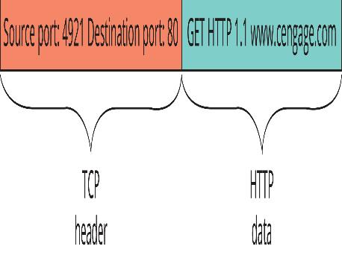
TCP: The Reliable Transport Layer (5 of 5)
Figure 5-17 An HTTP message with a TCP header

Slide 41
Internetwork Layer Protocols
The Internetwork layer is where IP protocol operates and is the heart of the TCP/IP protocol suite
The Internetwork layer is responsible for four main tasks:
Defines and verifies IP addresses
Routes packets through an internetwork
Resolves MAC addresses from IP addresses
Delivers packets efficiently

Slide 42
Defines and Verifies IP Addresses
An IP address is essential for devices using TCP/IP for communications
IP addresses are used for two main purposes:
To identify a network device at the Internetwork layer
To identify the network on which a device resides
When a device receives an IP packet, it compares the destination IP address with its own:
If it matches or is a broadcast, the packet is processed
It is does not match then it is discarded
Every IP address contains two parts: A network ID and a host ID

Slide 43
Routes Packets through an Internetwork
The Internetwork layer determines the best way to get a packet from network to network until it reaches its destination
Most large internetworks (the Internet) have multiple paths for getting from one network to another
Routers work at the Internetwork layer and it is their job to select the best path to the destination
Routers use the network ID portion of IP addresses along with their routing tables to determine the best path

Slide 44
Resolves MAC Addresses from IP Addresses
Every frame contains both physical (MAC) and logical (IP) source and destination addresses
When a packet is ready to be sent to the Network access layer, the destination device’s MAC address must be retrieved before the frame header can be constructed
TCP/IP uses Address Resolution Protocol (ARP) to find MAC addresses
ARP is discussed in more detail later in the chapter

Slide 45
Delivers Packets Efficiently
Internetwork layer protocols primarily focus on efficient delivery of packets
Features such as flow control, delivery confirmation or message assembly are not included in Internetwork layer protocols
These features require overhead to ensure reliable delivery
Internetwork layer protocols rely on the protocols in the Transport and Application layers to provide reliability features
These protocols are considered connectionless protocols, because they rely on upper layer protocols to ensure the packet’s safe journey

Slide 46
Protocols at the Internetwork Layer (1 of 6)
Internet Protocol Version 4 (IPv4) is also known as “IP”
IPv4 is the most common version in networks and the first version that was in widespread use
It defines a 32-bit dotted decimal IP address
Example: 172.31.149.10
Important fields in an IP packet:
Version, time to live (TTL), protocol, checksum, and source and destination addresses

Slide 47
Protocols at the Internetwork Layer (2 of 6)
Internet Protocol version 6 uses a different format for IP addresses than IPv4
IPv6 can run alongside IPv4 without needing to change the Transport Layer or Network Access Layer
Improvements and changes from IPv4:
Larger address space, hierarchical address space, autoconfiguration, built-in Quality of Service (QoS) support, built-in support for security, support for mobility, extensibility

Slide 48
Protocols at the Internetwork Layer (3 of 6)
Address Resolution Protocol (ARP) is used to resolve a logical (IP) address to physical (MAC) address
When a source doesn’t have the destination’s MAC it sends out an ARP broadcast frame requesting the MAC address corresponding to the host’s IP address
A network device configured with the specified IP address responds with an ARP reply containing its MAC address
To avoid sending an ARP request every time, PCs and other devices store learned IP address/MAC address pairs in an ARP cache which is a temporary location in RAM

Slide 49
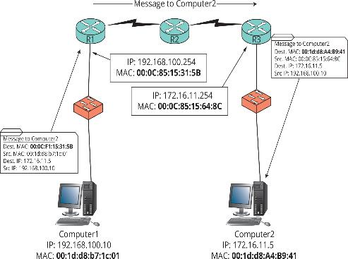
Protocols at the Internetwork Layer (4 of 6)
Figure 5-19 How MAC addresses are used in an internetwork

Slide 50
Protocols at the Internetwork Layer (5 of 6)
Internet Control Message Protocol (ICMP) is used to send error, status, and control messages between systems or devices
The ping program uses ICMP Echo packets to request a response from another computer or to verify whether it is available for communication
A ICMP Echo Reply packet indicates whether the host is reachable and how long the message’s round trip from sender to receiver took
The tracert program uses ICMP Echo packets to determine the route a packet takes through an internetwork
ICMPv6 does not use ARP to resolve MAC addresses, it uses neighbor discovery protocol (NDP)

Slide 51
Protocols at the Internetwork Layer (6 of 6)
Internet Protocol Security (IPsec) works with IPv4 to ensure secure delivery of packets
IPsec can be used to secure sensitive network transmissions between computers that need extra security
This protocol provides security by using authentication and encryption
IPsec requires additional network/computer resources, so it should be enabled only for highly sensitive communication and in environments where security risks are high

Slide 52
Network Access Layer Protocols (1 of 2)
Some tasks performed by the Network access layer:
Provides a physical (MAC) address for the network interface
Verifies incoming frames have the correct destination MAC address
Defines and follows media access rules
Receives packets from the Internetwork layer and encapsulates them to create frames
De-encapsulates received frames and sends the resulting packets to the Internetwork layer
Often provides frame error detection in the form of a CRC code

Slide 53
Network Access Layer Protocols (2 of 2)
Some tasks performed by the Network access layer (continued):
Transmits and receives bit signals
Defines the signaling needed to transmit bits, whether electrical, light pulses, or radio waves
Defines the media and connectors needed to make a physical network connection

Slide 54
Knowledge Check Activity 5-2
Which field in a Transport layer protocol header specifies the destination Application layer protocol?
a. TTL
b. Checksum
c. Port
d. Sequence number

Slide 55
Knowledge Check Activity 5-2: Answer
Which field in a Transport layer protocol header specifies the destination Application layer protocol?
Answer: c. Port
Explanation: The destination port number in a Transport layer header specifies the destination Application layer protocol to which the segment or datagram should be delivered. The source port number identifies the Application layer protocol that sent the message.

Slide 56
Self Assessment
Explain the differences between TCP and UDP. Why would an Application layer protocol use TCP instead of UDP?
When a Windows computer is configured to use DHCP, but no DHCP server is available, what type of address is configured automatically?

Slide 57
Summary
Now that the lesson has ended, you should be able to:
Describe the purpose of a network protocol and the layers in the TCP/IP architecture
Describe TCP/IP Application layer protocols
Describe TCP/IP Transport layer protocols
Describe TCP/IP Internetwork layer protocols
Describe TCP/IP Network access layer protocols

